Slide 1


Microprocessor Architecture and Internet of Things
Course Code: CET3014B Credits: 3 TH+2 Lab=5

Slide 2
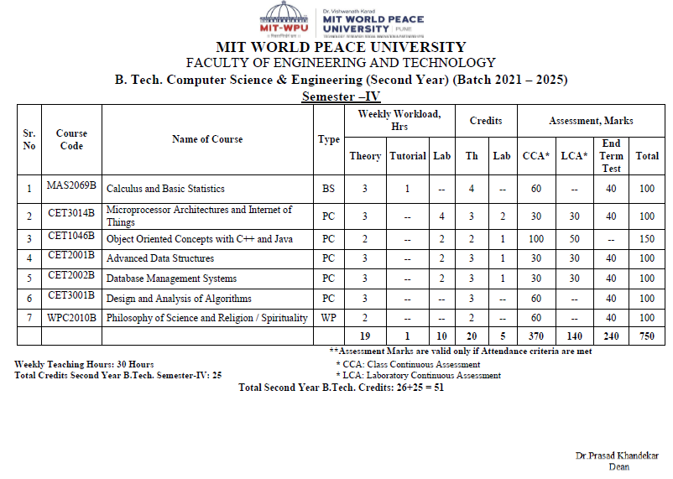
Course Structure - SY

Slide 3
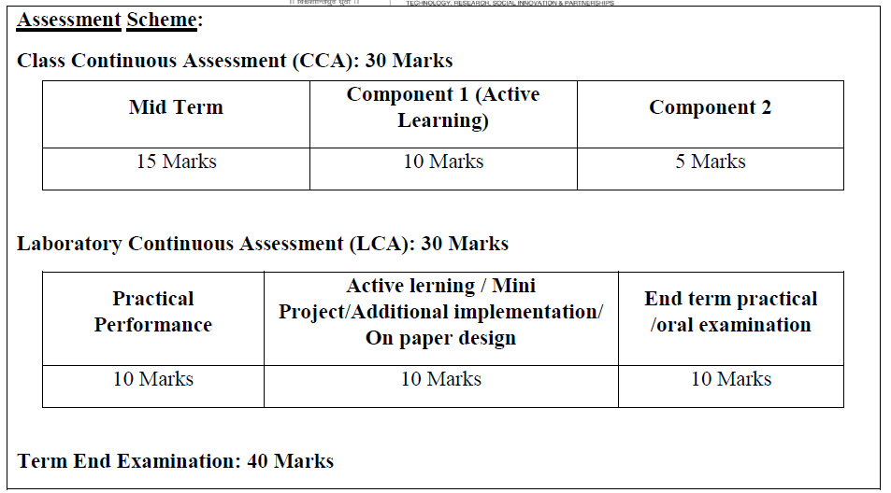
CCA LCA

Slide 4
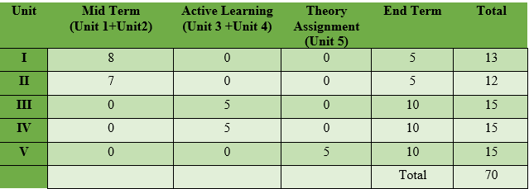
Unit wise distribution of CCA-70 Marks
LCA-30 Marks

Slide 5
Syllabus
Unit 5: Pentium Task Management and Interrupt handling:
Task Management, support registers, related data structures, Task switching.
Interrupt and Exception Overview.
Sources of Interrupts & exceptions, Exception and Interrupt Vectors.
Interrupt Descriptor Table (IDT), IDT Descriptors.
Exception- or Interrupt-Handler Procedures

Slide 6
Syllabus
Module I: Overview of Embedded System and IoT
Module II:Pentium Architecture:
Embedded Systems: Architecture & Characteristics of ES, Types of Embedded systems, Examples of Embedded Systems. Introduction of IoT: Definition and characteristics of IoT, Technical Building blocks of IoT, Device, Communication Technologies, Data, Physical design of IoT, IoT enabling technologies, IoT Issues and Challenges- Planning, Costs and Quality, Security and Privacy, Risks. Example: Smart Home /Smart Agricultural.
Pentium features, Pentium superscalar architecture - Pipelining, Branch prediction, and Instruction and Data caches. The Floating-Point Unit: features, pipeline stages & data types. Pentium programmer's model, register set, System registers, addressing modes and Instruction set.

Slide 7
Syllabus
Module III:Pentium operating modes:
Pentium Modes of Operation, Pentium Real address mode: Memory organization, Memory segments, segment registers, logical to physical address generation
Protected mode: Segmentation unit support registers, related instructions, segment Memory descriptors, logical to linear address translations.
Module IV:Paging and Protection:
Paging Unit: support registers, related data structures, linear to physical address translation, TLB Protection by segmentation, privilege-levels, rules of inter-privilege level transfer for data and code segments, page level protection.

Slide 8

Timesharing
Allows multiple users to use the same computer.
Provides economical use of processing resources.
Is invisible to the users.
Can work for any number of users.

Slide 9
Elements required to maintain Timesharing
When to change from one user to the next?
When a user’s time slice expires, computer must store the current state of the program and restart the next user’s program as it was left when its time slice expired.
To save the current state of program is called context and changing to next user’s program is called context switch.

Slide 10
A context switch
Is necessary to perform timesharing saves the state of the current program.
Loads the state of the program allows any program to be restarted at any time.
The basic unit of multitasking is the task.

Slide 11
What is a Task?
A program or a group of program defined by OS as a task.
For Multiuser system, a task can be assigned to each user.
A task is a unit of work that a processor can dispatch, execute, and suspend.
When operating in protected mode, all processor execution takes place from within a task.
A task is invoked by an interrupt, exception, jump, or call.
Even simple systems must define at least one task.

Slide 12

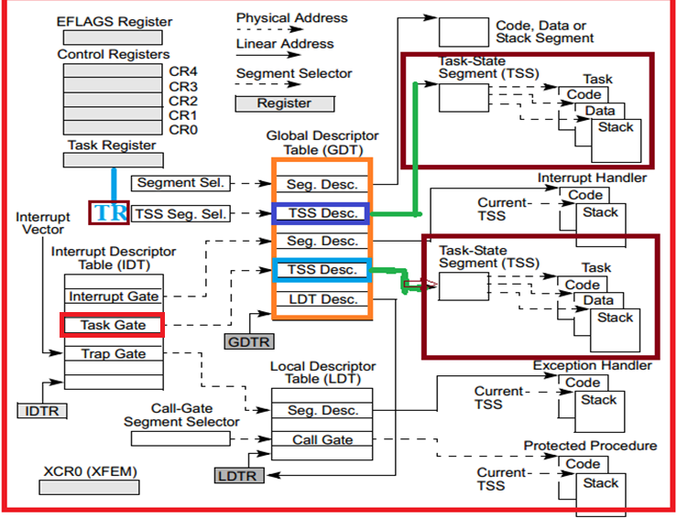
Task Structure

Slide 13
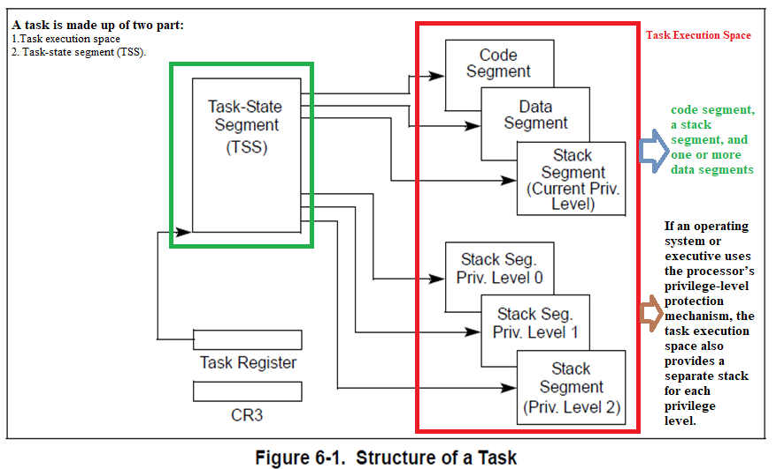
Task structure

Slide 14
Task Structure
A task is made up of two parts: a task execution space and a task-state segment (TSS). TSS requires 104 bytes (68 H) memory space.
The task execution space consists of a code segment, a stack segment, and one or more data segments.
The TSS specifies the segments that make up the task execution space and provides a storage place for task state information.
In multitasking systems, the TSS also provides a mechanism for linking tasks.
A task is identified by the segment selector for its TSS. When a task is loaded into the processor for execution, the segment selector, base address, limit, and segment descriptor attributes for the TSS are loaded into the Task Register (TR).

Slide 15
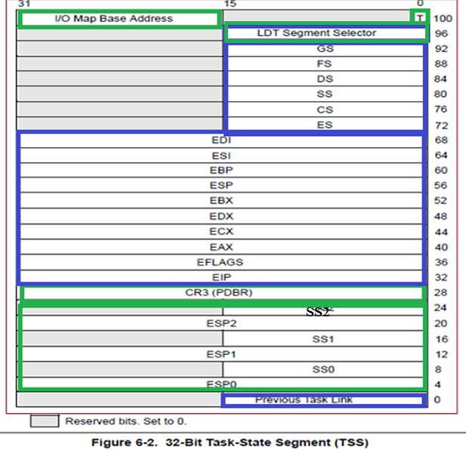
Static set (Green Colour)
TSS- Task State Segment
It is that where processor reads but does not change.
This set includes the fields that store: The selector of the task's LDT.
The register (PDBR) that contains the base address of the task's page directory (read only when paging is enabled).
Pointers to the stacks for privilege levels 0-2.
The T-bit (debug trap bit) which causes the processor to raise a debug exception when a task switch occurs.
The I/O map base address
Dynamic set
where processor updates with each switch from the task.
This set includes the fields that store: The general registers (EAX, ECX, EDX, EBX, ESP, EBP, ESI, EDI).
The segment registers (ES, CS, SS, DS, FS, GS).
The flags register (EFLAGS).
The instruction pointer (EIP).
The selector of the TSS of the previously executing task (updated only when a return is expected).

Slide 16
Task State
The task’s current execution space, defined by the segment selectors in the segment registers (CS, DS, SS, ES, FS, and GS).
• The state of the general-purpose registers.
• The state of the EFLAGS register.
• The state of the EIP register.
• The state of control register CR3.
• The state of the Task Register (TR).
• The state of the LDTR register.
• The I/O map base address and I/O map (contained in the TSS).
• Stack pointers to the privilege 0, 1, and 2 stacks (contained in the TSS).
• Link to previously executed task (contained in the TSS).

Slide 17
Executing a Task
Software or the processor can dispatch a task for execution in one of the following ways:
A explicit call to a task with the CALL instruction.
A explicit (direct) jump to a task with the JMP instruction.
An implicit (indirect) call (by the processor) to an interrupt-handler task.
A return (initiated with an IRET instruction) when the NT flag in the EFLAGS register is set.

Slide 18
Executing a Task
When a task is dispatched for execution, a task switch automatically occurs between the currently running task and the dispatched task.
During a task switch, the execution environment of the currently executing task (called the task’s state or context) is saved in its TSS and execution of the task is suspended.
The context for the dispatched task is then loaded into the processor and execution of that task begins with the instruction pointed to by the newly loaded EIP register.
If the currently executing task (the calling task) called the task being dispatched (the called task), the TSS segment selector for the calling task is stored in the TSS of the called task to provide a link back to the calling task.

Slide 19
TASK MANAGEMENT DATA STRUCTURES
Task State Segment (TSS)
Task State Segment Descriptor
Task Register (TR)
Task Gate Descriptor
NT flag in the EFLAGS register.
In protected mode:
TSS and TSS descriptor must be created for at least one task.
And the segment selector for the TSS must be loaded into the Task Register TR (using the LTR instruction).

Slide 20
TSS- Task State Segment
Each task must have a TSS associated with it.
TSS stores all the information the processor needs in order to manage a task.
The current TSS is identified by a special register the Task State Segment Register (TR).
This register contains a selector referring to the task state segment descriptor that defines the current TSS.
The fields of a TSS are divided into two main categories: Dynamic fields and Static fields.

Slide 21
TSS
1. A dynamic set that the processor updates with each switch from the task.
This set includes the fields:
The General Purpose Registers (EAX, ECX, EDX, EBX, ESP, EBP, ESI, EDI).
These are saved in the same order in which PUSHAD (Push All double General-Purpose Registers:Pushes the contents of the general-purpose registers onto the stack) instruction saves them.
The segment registers (ES, CS, SS, DS, FS, GS).
The flags register (EFLAGS).
The instruction pointer (EIP).
Previous task link field (back link field):
Contains the segment selector for the TSS of the previous task permits a task switch back to the previous task to be initiated with an IRET instruction.

Slide 22
Static set
A static set that the processor reads but does not change. These fields are set up when a task is created. The fields of this set are:
The selector of the task's LDT.
The CR3 register(PDBR): contains the base address of the task‘s page directory (read only when paging is enabled).
Pointers to the stacks for privilege levels 0-2.
These stack pointers consist of a logical address made up of the segment selector for the stack segment (SS0, SS1, and SS2) and an offset into the stack (ESP0, ESP1, and ESP2). Note that the values in these fields are static for a particular task; whereas, the SS and ESP values will change if stack switching occurs within the task.
The T-bit (debug trap bit) which causes the processor to raise a debug exception when a task switch occurs.

Slide 23
Static set cont-
The I/O map base address
Contains a 16-bit offset from the base of the TSS to the I/O permission bit map and interrupt redirection bitmap.
When present, these maps are stored in the TSS at higher addresses.
The I/O map base address points to the beginning of the I/O permission bit map and the end of the interrupt redirection bit map.

Slide 24
Two classes of TSS format
Static set
It is that where processor reads but does not change.
This set includes the fields that store: The selector of the task's LDT.
The register (PDBR) that contains the base address of the task's page directory (read only when paging is enabled).
Pointers to the stacks for privilege levels 0-2.
The T-bit (debug trap bit) which causes the processor to raise a debug exception when a task switch occurs.
The I/O map base address
Dynamic set
where processor updates with each switch from the task.
This set includes the fields that store: The general registers (EAX, ECX, EDX, EBX, ESP, EBP, ESI, EDI).
The segment registers (ES, CS, SS, DS, FS, GS).
The flags register (EFLAGS).
The instruction pointer (EIP).
The selector of the TSS of the previously executing task (updated only when a return is expected).

Slide 25
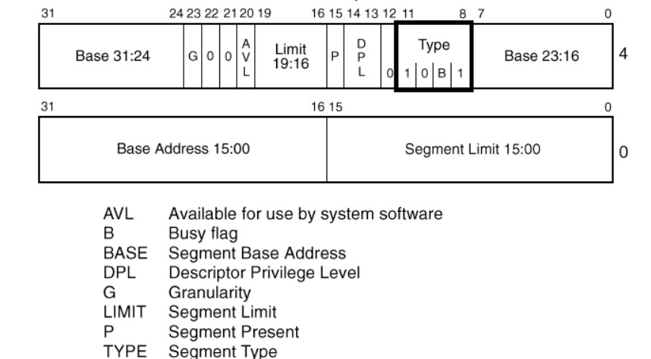
Task State Segment Descriptor
B=0 Non Busy Task
B=1 Busy Task
Fig. 2 :TSS Descriptor(32 bit)

Slide 26
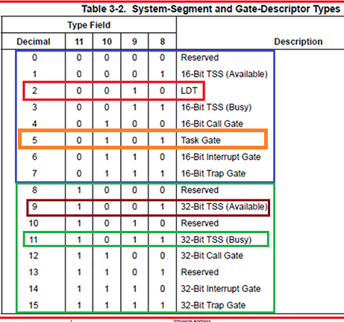

Slide 27
TSS Descriptor
The TSS, like all other segments, is defined by a segment descriptor, it holds base address of TSS assigned to that task.
TSS descriptors may only be placed in the GDT; they cannot be placed in an LDT or the IDT.
An attempt to identify a TSS with a selector that has TI=1 (indicating the current LDT) results in an exception.

Slide 28
TSS Descriptor
The B-bit in the type field indicates whether the task is busy. A type code of 9 (1001B) indicates a non-busy (Available) task; a type code of 11(1011B) indicates a busy task.
The processor uses the Busy bit to detect an attempt to call a task whose execution has been interrupted.
Tasks are not reentrant/recursive.
The BASE, LIMIT, and DPL fields and the G-bit and P-bit have functions similar to their counterparts in data- segment descriptors.
The Limit field must have a value equal to or greater than 103(67H), one byte less than the minimum size of a task state. An attempt to switch to a task whose TSS descriptor has a limit less than 67H generates an exception.
Max(CPL,RPL) <= TSS DPL

Slide 29
How does Processor know which TSS to save the old task in?
In case of a Task switch, processor saves its complete context in a TSS and load a new context from another TSS.
When a new task begins, Task Register is updated with a selector to new task’s TSS.
Current context is saved in the TSS pointed to by Task Register.

Slide 30
TR: Task Register
It holds 16 bit selector pointing to TSS descriptor (in GDT ) of current task being executed by processor.
The task register has both a "visible" portion and an "invisible" portion.
The selector in the visible portion selects a TSS descriptor in the GDT.
The processor uses the invisible portion to cache the base and limit values from the TSS descriptor.

Slide 31
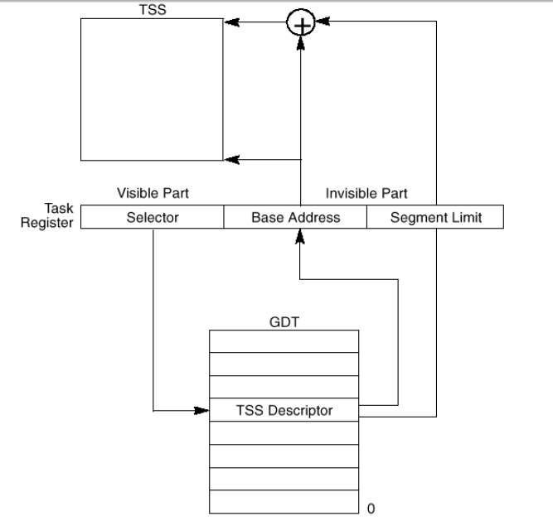
Task Register
Fig. 3 :Task Register

Slide 32
Task Register
LTR (Load task register) :
Loads the visible portion of the task register with the operand, which must index to a TSS descriptor in the GDT.
The LTR instruction also loads the invisible portion with information from the TSS descriptor.
The LTR instruction is a privileged instruction; it may be executed only when the CPL is 0.
The LTR instruction generally is used during system initialization to put an initial value in the task register; afterwards, the contents of the TR register are changed by events which cause a task switch.
STR (Store task register):
Stores the visible portion of the task register in a general register or memory.
STR is not privileged.

Slide 33
Virtual memory to each task
GDT- 8191 descriptors
LDT- 8192 descriptors
Each descriptor can define a segment up to 4GB
Total memory = 4GB (8191+8192)
= 4GB x 16381
= 64 Tera Bytes

Slide 34
Task Gate
In Task switch, a program is deliberately putting itself to sleep and awakening another.
The new task receives no parameters from the old task.
Two tasks are totally separate.
Task Switch can take place either through TSS descriptor or through Task Gate.

Slide 35
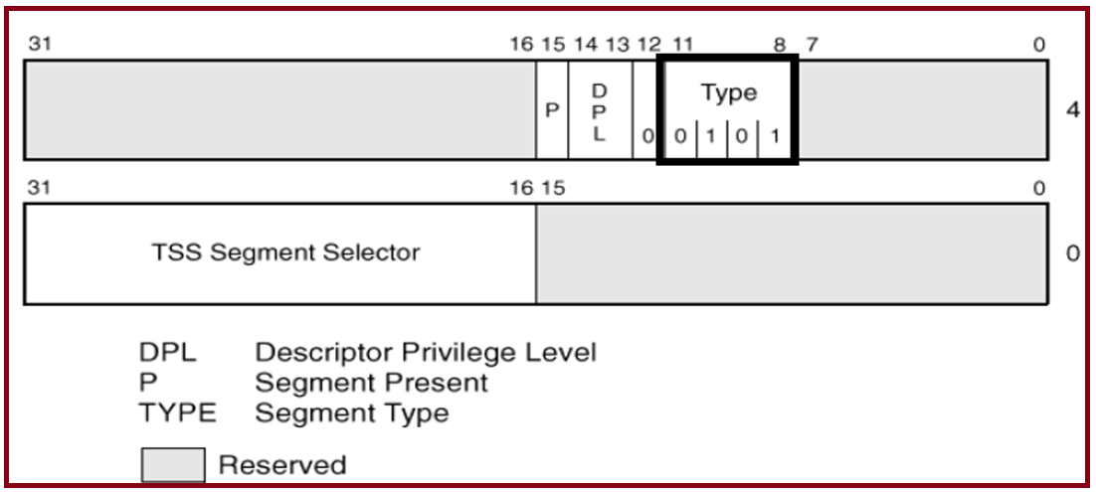
Task Gate Descriptor
Fig. 5 :Task Gate Descriptor

Slide 36
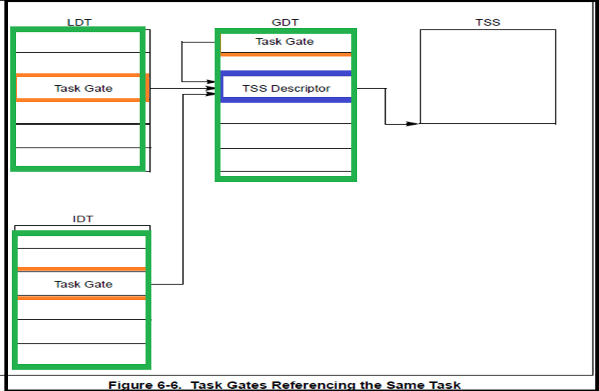
How both a Task Gate in the LDT and a Task Gate in an IDT can identify the same task.

Slide 37
Task Gate Descriptor
A task gate descriptor provides an indirect, protected reference to a TSS. Figure 5 illustrates the format of a task gate descriptor.
The SELECTOR field of a task gate must refer to a TSS descriptor. The value of the RPL in this selector is not used by the processor.
The DPL field of a task gate controls the right to use the descriptor to cause a task switch.
A procedure may not select a task gate descriptor unless the maximum of the selector's RPL and the CPL of the procedure is numerically less than or equal to the DPL of the descriptor.
Task gate can reside anywhere in GDT, LDT or IDT.
Max(CPL,RPL) <= TSS DPL

Slide 38
Task Switching
The Processor switches execution to another task in any of Four cases:
The current task executes a JMP or CALL that refers to a TSS descriptor.
The current task executes a JMP or CALL that refers to a task gate.
An interrupt or exception vectors to a task gate in the IDT.
The current task executes an IRET when the NT flag is set.

Slide 39
A task switching operation involves these steps:
Checking that the current task is allowed to switch to the designated task (New task).
Checking that the TSS descriptor of the new task is marked present and has a valid limit.
Saving the state of the current task.
Loading the task register with the selector of the incoming (New) task’s TSS descriptor
Loading the incoming(New) task’s state from its TSS and continue execution

Slide 40
NT : Nested Task
The previous task link field of the TSS (sometimes called the “back link”) and the NT flag in the EFLAGS register are used to return execution to the previous task.
The NT flag indicates whether the currently executing task is nested within the execution of another task.
The previous task link field of the current task's TSS holds the TSS selector for the higher-level task .

Slide 41
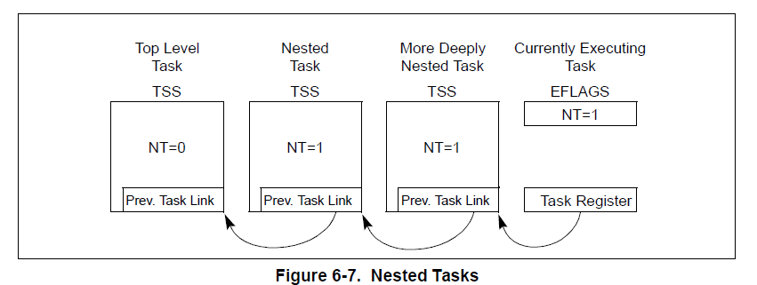
Task Linking

Slide 42
IOPL Flag
This two-bit field applies to Protected Mode.
IOPL indicates the numerically maximum CPL value permitted to execute I/O instructions without generating an exception fault or consulting the I/O Permission Bitmap.
Task switches can always alter the IOPL field, when the new flag image is loaded from the incoming task's TSS.
I/O instructions can be unconditionally performed when CPL <= IOPL.
The I/O instructions are IN, OUT, INS (Input from Port to String), OUTS(Output String to Port), REP.
When CPL > IOPL, and the current task is associated with a TSS, the I/O Permission Bitmap (TSS) is consulted on whether I/O to the port is allowed for that task.

Slide 43
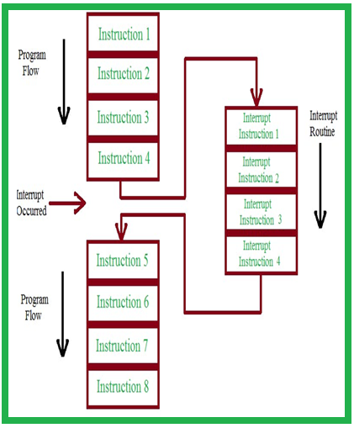
Interrupt and Exception Overview
Interrupts and Exceptions : are unexpected events which will disrupt the normal flow of execution of instruction (that is currently executing by processor).
An Exception is an unexpected event from within the processor.
Interrupt is an unexpected event from outside the process.
An example of an interrupt is a signal to stop Microsoft Word so that a PowerPoint presentation can gear up.

Slide 44
Interrupt and Exception Overview
Interrupts occur at random times during the execution of a program, in response to signals from hardware.
System hardware uses interrupts to handle events external to the processor, such as requests to service peripheral devices. Software can also generate interrupts by executing the INT n instruction.
Exceptions occur when the processor detects an error condition while executing an instruction, such as division by zero.
The processor detects a variety of error conditions including protection violations, page faults, and internal machine faults.

Slide 45
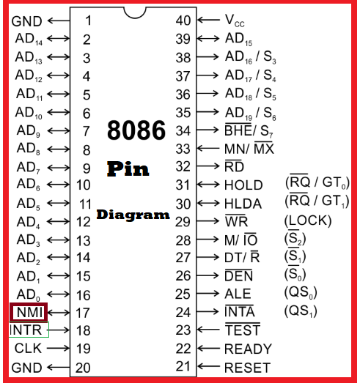
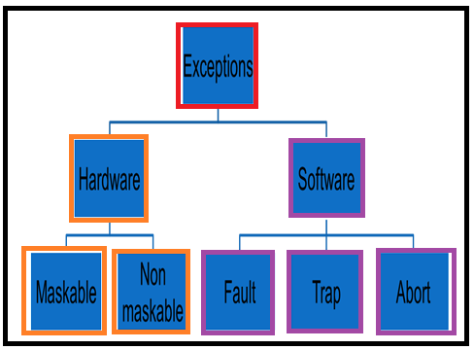
Classes of Exceptions
Maskable Hardware interrupts:
Are signaled through the INTR pin
Can be ignored by clearing IF flag in EFLAGs
=========================
NMI: Non Makeable Hardware interrupts:
Are signaled through NMI pin Can’t be ignored
===========================
Exceptions: Generated when the CPU detects an anomalous condition while executing an instruction.
These are further divided into three groups Faults, Traps and Aborts
External
NMI
INTR

Slide 46
Sources of the Interrupts
The processor receives interrupts from two sources:
• External (Hardware generated) interrupts.
• Software-generated interrupts.
External (Hardware generated) interrupts
Maskable interrupts, which are signalled via the INTR pin.
Nonmaskable interrupts, which are signalled via the NMI (Non-Maskable Interrupt) pin.
Software-generated interrupts
Software interrupts are initiated by executing the interrupt instruction INT in a program. Software interrupts are mainly used in accessing I/O devices such as the keyboard, printer, screen, disk drive etc. If vector number 2 (the NMI vector) is used in this instruction, the NMI interrupt handler is called, but the processor’s NMI-handling hardware is not activated.

Slide 47
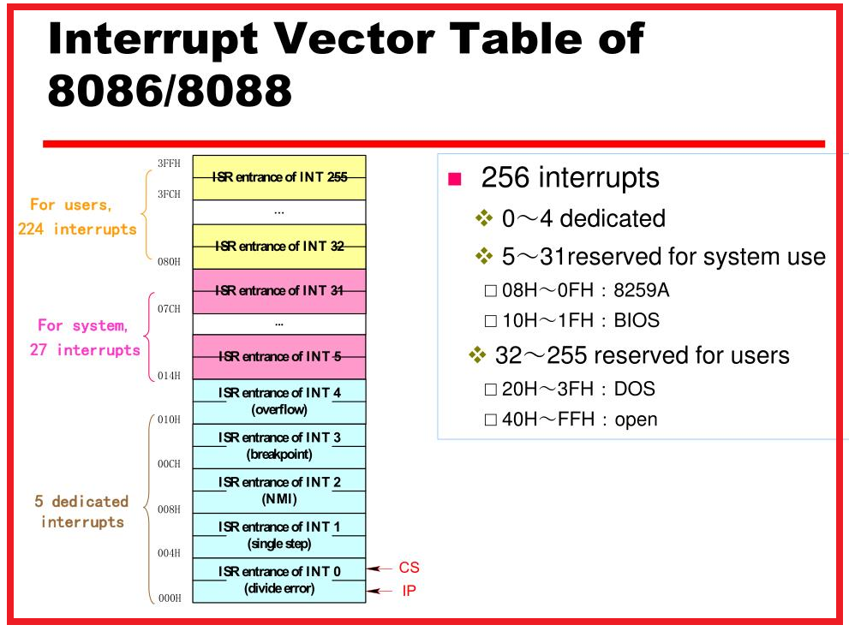

Slide 48
Sources of the Exceptions
The processor receives exceptions from three sources:
• Processor-detected program-error exceptions.
Software-generated exceptions.
• Machine-check exceptions.
Processor-detected program-error exceptions: The processor generates one or more exceptions when it detects program errors during the execution in an application program or the operating system or executive.
These are further classified as Faults, Traps, and Aborts.
Software-generated exceptions: The INT 0, INT 3, and BOUND instructions permit exceptions to be generated in software. These instructions allow checks for exception conditions to be per

Slide 49
Sources of the Exceptions cont-
Machine-check exceptions:
The P6 family and Pentium processors provide both internal and external machine-check mechanisms for checking the operation of the internal chip hardware and bus transactions. “Interrupt 18 (Machine-Check Exception (#MC)”)

Slide 50
Exception Classifications
Exceptions are classified as faults, traps, or aborts depending on the way they are reported and whether the instruction that caused the exception can be restarted.
1. Trap
A trap is an exception that is reported immediately following the execution of the trapping instruction. Traps allow execution of a program or task to be continued without loss of program continuity. (e.g. breakpoint, division by zero, invalid memory access). The main use of traps is for debugging purposes.
The role of the interrupt signal in this case is to notify the debugger that a specific instruction has been executed (for instance, a breakpoint has been reached within a program).
Example
INT 3 : Breakpoint
INT 4: Overflow

Slide 51
Exception Classifications
2. Fault – A fault is an exception that can generally be corrected and that, once corrected, allows the program to be restarted with no loss of continuity.
They are detected before an error occurs. The faulting instruction can be restarted. Can generally be corrected; once corrected, the program is allowed to restart with no loss of continuity.
The saved value of EIP is the address of the instruction that caused the fault, and hence that instruction can be resumed when the exception handler terminates.
Example
INT 0 : Divide error
INT 6 : Invalid op-code

Slide 52
Exception Classifications
3. Abort – It is a type of exception occurs when an instruction fetch causes an error.
Aborts are used to report severe errors, such as hardware failures and invalid or inconsistent values in system tables.
The interrupt signal sent by the control unit is an emergency signal used to switch control to the corresponding abort exception handler.
This handler has no choice but to force the affected process to terminate.
Example
INT 8 : Double fault

Slide 53
Protected Mode Exception and Interrupt Vectors
The interrupt descriptor table, often abbreviated to IDT or simply ID, is an array of pointers to functions.
It is associated by the CPU to handle specific exceptions, such as faults, system service requests from the application, and interrupt requests from peripherals.
The allowable range for vector numbers is 0 to 255. Vector numbers in the range 0 through 31 are reserved by the Intel 64 architectures.
Vector numbers in the range 32 to 255 are designated as user-defined interrupts and are not reserved by the Intel 64 and IA-32 architecture.

Slide 54
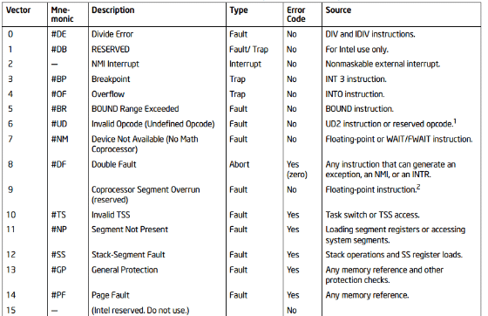
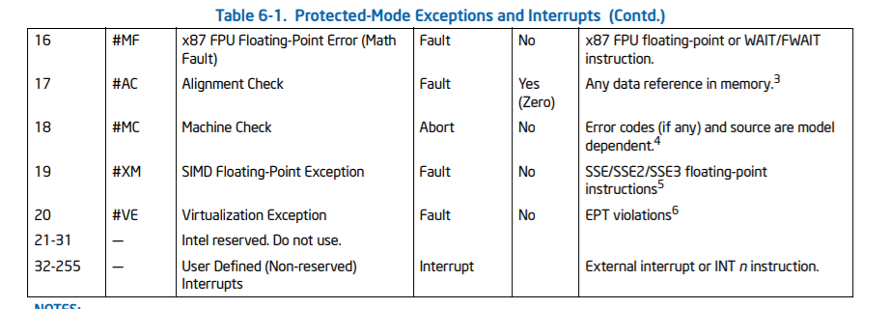
Protected Mode Exception and Interrupt Vectors

Slide 55
General Protection Fault 13
Violation of segment limit
Write attempt to read only data segment
Read attempt to execute only code segment
Loading selector with wrong value
Switching to a busy task
Violation of privilege rules
Leaving virtual mode with wrong interrupt handler.

Slide 56
IDT-Interrupt Descriptor Table
The interrupt descriptor table (IDT) associates each interrupt or exception identifier with a descriptor for the instructions that service the associated event. Like the GDT and LDTs.
The IDT is an array of 8-byte descriptors. Unlike the GDT and LDTs, the first entry of the IDT may contain a descriptor.
The IDT consists of a gate descriptors
Each gate descriptor is of 8 bytes size
IDT consists of 256 gate descriptor
The processor locates the IDT by means of the IDT register (IDTR)
The instructions LIDT and SIDT operate on the IDTR. This instruction can be executed only when the CPL is 0.

Slide 57
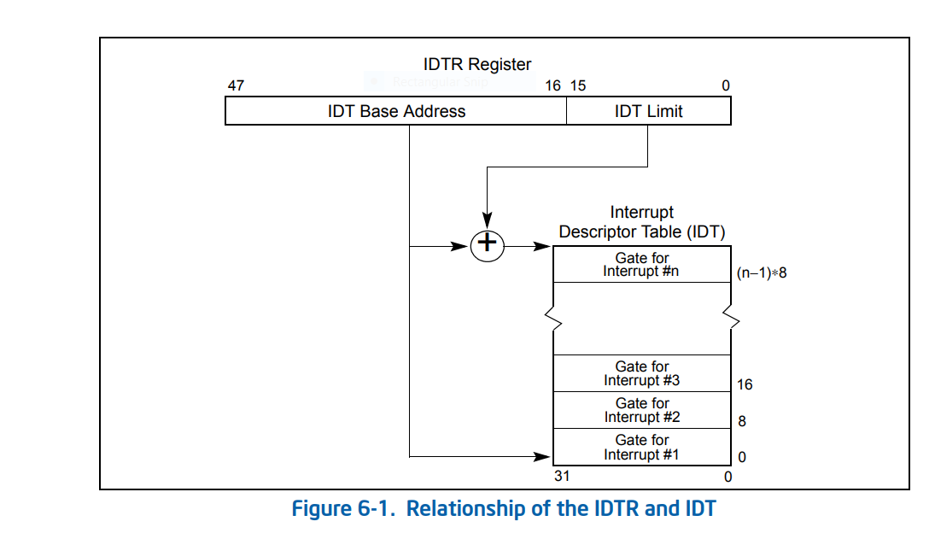
IDT-Interrupt Descriptor Table

Slide 58
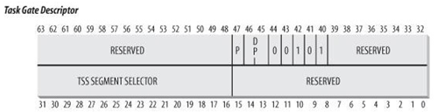
IDT Descriptors
The IDT may contain any of three kinds of gate descriptors:
• Task-gate descriptor (0101)
• Interrupt-gate descriptor (1110)
• Trap-gate descriptor (1111)
Task-gate descriptor: The format of a task gate used in an IDT is the same as that of a task gate used in the GDT or an LDT.
Each gate descriptor holds only a selector to a code segment and 32 bit offset where execution begin.
It points to the first instruction of ISR. The DPL field works at level 3 to allow access for all.

Slide 59
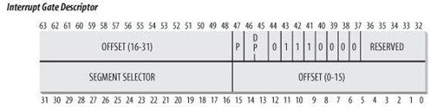
IDT Descriptors
Interrupt Gate Descriptor:
When an exception vector access through interrupt Gate, Pentium processor clears IF (Interrupt Flag) before executing first instruction of ISR.
Pentium Processor masks all further hardware initiated interrupts until ISR is done. But it can’t mask NMI and software interrupt.

Slide 60
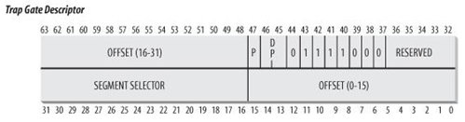
IDT Descriptors
Trap gate Descriptor: On exception generation if Pentium selects trap gate form IDT.
It saves its internal state (EFLAGES,CS,EIP,SS etc)
Performs an intersegment transfer of control to said location in gate.
Selector must point to executable code segment ,it can’t point to another descriptor
Execution continues till IRET instruction

Slide 61
Advantages / Disadvantage of using Task Gate over Trap/Interrupt Gate
Entire context of interrupted task is saved automatically
Exception handler can run in an environment that is known to be good
Exception handler can use its own privilege code and data space because it can have its own LDT.
Requires more time to perform a task switch than it does to stack a few bytes
Task gate can’t specify where in task to begin execution. Dormant tasks always resume where they left off
It is difficult to retrieve any information about interrupted code when it is in a different task

Slide 62
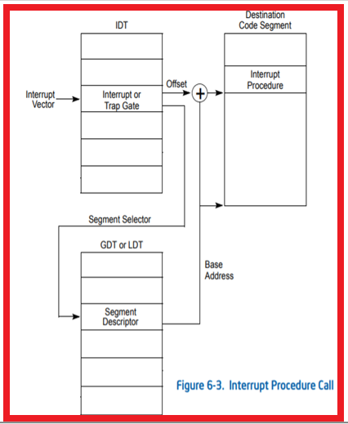
Exception or Interrupt Handler Procedures
An interrupt gate or trap gate references an exception- or interrupt-handler procedure that runs in the context of the currently executing task.
The segment selector for the gate points to a segment descriptor for an executable code segment in either the GDT or the current LDT.
The offset field of the gate descriptor points to the beginning of the exception- or interrupt-handling procedure.

Slide 63
Exception or Interrupt Handler Procedures
When the processor performs a call to the exception- or interrupt-handler procedure:
If the handler procedure is going to be executed at a numerically lower privilege level, a stack switch occurs. When the stack switch occurs:
a. The segment selector and stack pointer for the stack to be used by the handler are obtained from the TSS for the currently executing task. On this new stack, the processor pushes the stack segment selector and stack pointer of the interrupted procedure.
b. The processor then saves the current state of the EFLAGS, CS, and EIP registers on the new stack.
c. If an exception causes an error code to be saved, it is pushed on the new stack after the EIP value.

Slide 64
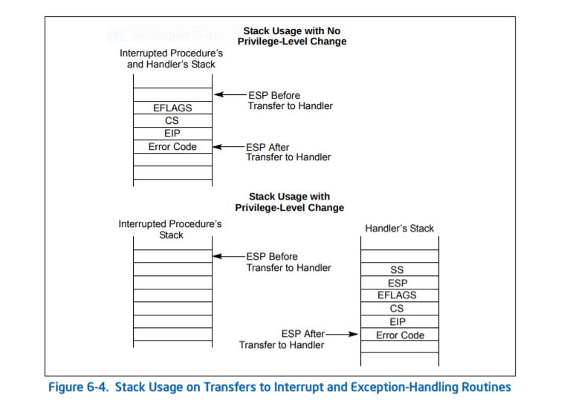
Exception or Interrupt Handler Procedures
If the handler procedure is going to be executed at the same privilege level as the interrupted procedure:
The processor saves the current state of the EFLAGS, CS, and EIP registers on the current stack (see Figures 6-4).
If an exception causes an error code to be saved, it is pushed on the current stack after the EIP value

Slide 65
Thank You

